Slide 1
Safe Reader:
An e-Reader Utility App

Slide 2
TEAM MEMBERS
Erik David (emd15b)
Kevin Turner Jr. (kbt15b)
Christian Watkins (ccw14c)

Slide 3
Initial project concept
Safe Reader is envisioned as a utility app that complements the features found in stand-alone e-Readers, such as the Nook and Kindle.
It aims to extend the functionality of these applications and make them more accessible to those with visual impairments (our target demographic)
Core application features include:
Autoscaling of text (font size adjusts itself based on user proximity)
Night mode (invert text and background color to reduce eye strain)
Automatically adjust brightness level based on proximity (may not show up on the emulator, but should show up on an Android device

Slide 4
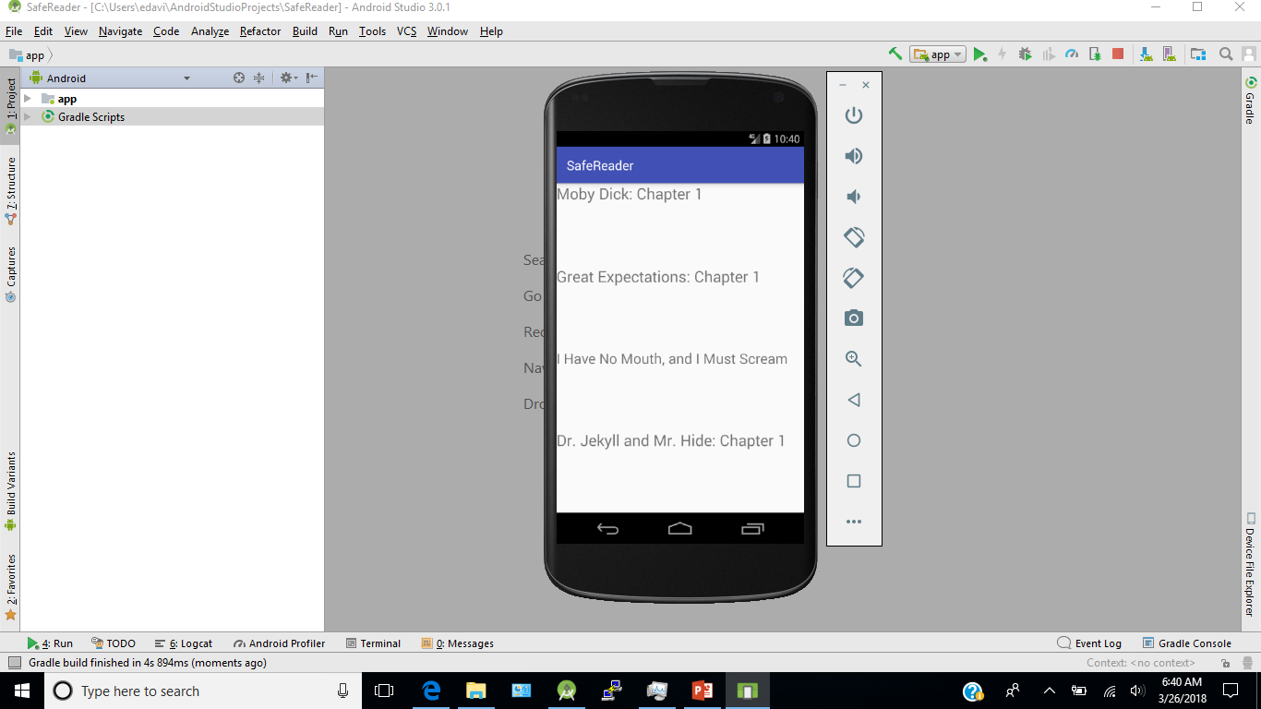

Slide 5
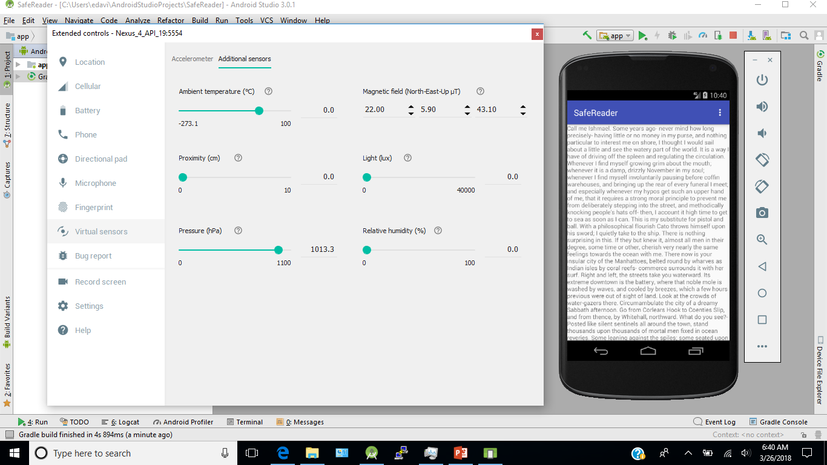

Slide 6


Slide 7
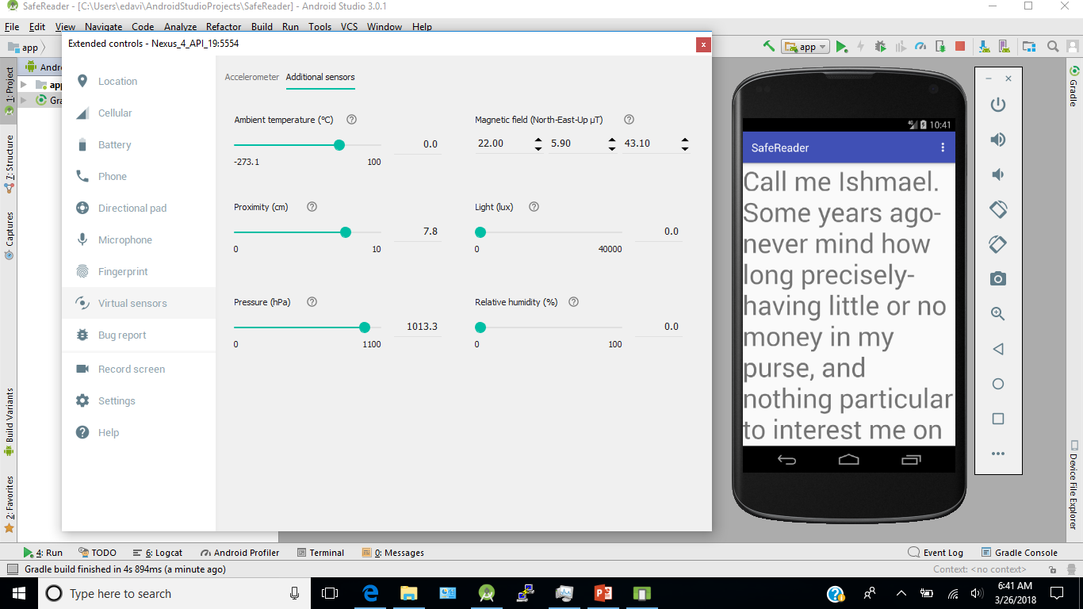

Slide 8
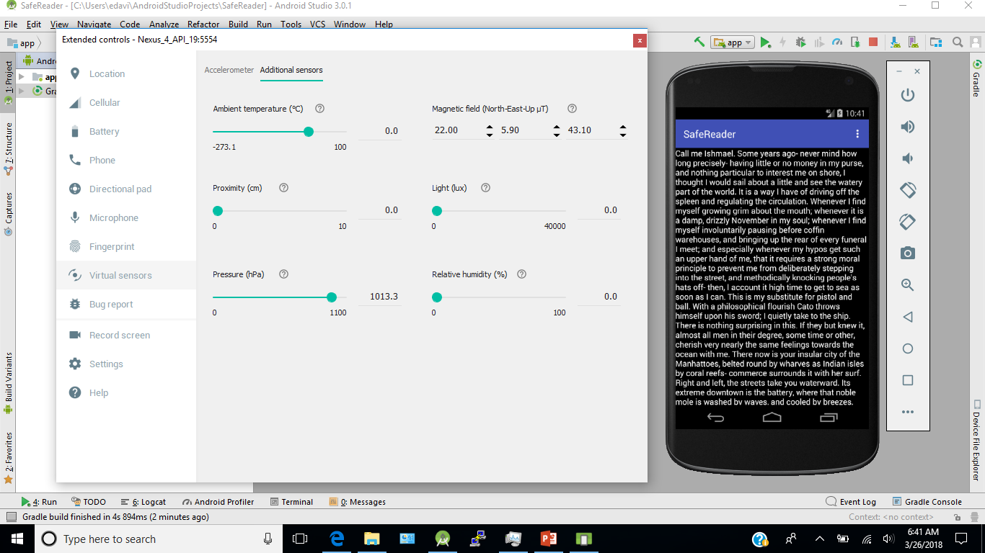

Slide 9
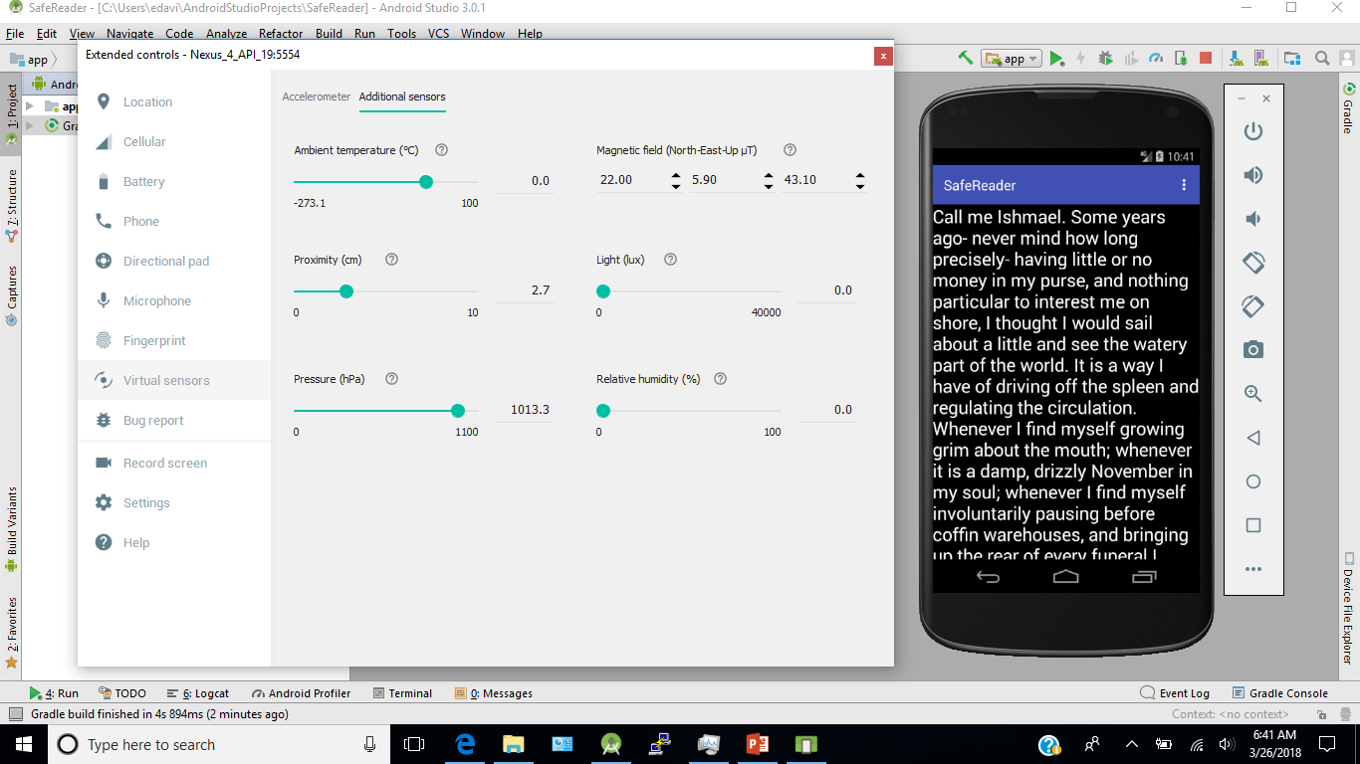

Slide 10
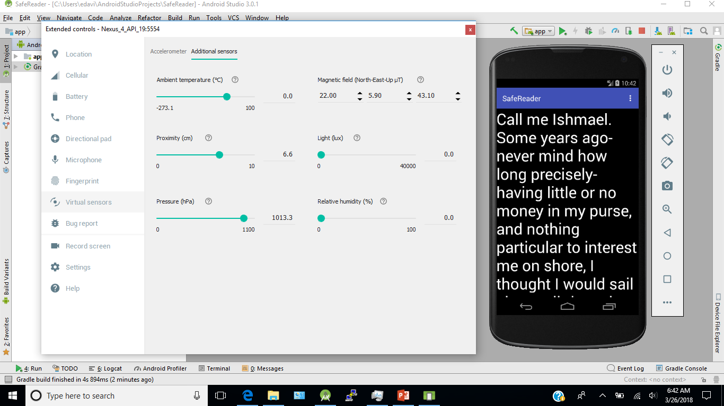

Slide 11
IDEAS FOR FUTURE DEVELOPMENT
Expanding options available to the user (streamlining the interface and adding more customization options)
Additional functionality that could be added includes:
greater choice of text and background color combinations
adapting autoscaling to work on multiple file types (.txt, .pdf, .png)
incorporating some sort of text-to-speech functionality
These features would help market the app to a broader audience

Slide 12
ANY QUESTIONS?

